Slide 1
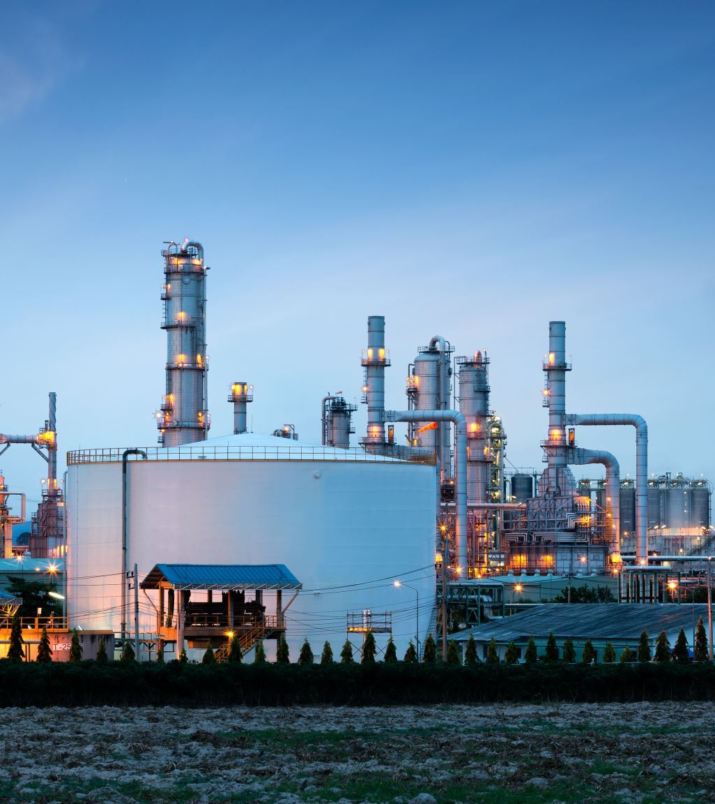
Air Quality Analysis And Prediction In Tamil Nadu
Rapid industrialization, vehicular emissions, and natural factors contribute to deteriorating air quality, affecting the well-being of residents. We aim to develop a comprehensive air quality analysis and prediction system for Tamil Nadu, leveraging machine learning and environmental data.

Slide 2
INOVATIVE SOLUTION
Developing innovative solutions for air pollution analysis and prediction in Tamil Nadu, or any region, is crucial for addressing the growing environmental and health challenges associated with poor air quality.

Slide 3
.
Here are some innovative ideas and technologies that can be implemented:
Air Quality Monitoring Network Expansion: Expanding the existing air quality monitoring network in Tamil Nadu by deploying more sensors across urban and rural areas. These sensors can provide real-time data, which can be used for accurate pollution analysis.
Satellite Data Integration: Incorporate satellite data and remote sensing technology to monitor air quality on a broader scale. Satellite imagery can provide valuable insights into regional and seasonal trends in air pollution.

Slide 4
Community Engagement: Encourage community involvement in air quality monitoring and solutions. Establish local committees or organizations dedicated to addressing air pollution issues.
Early Warning Systems: Create an early warning system that can alert residents and authorities to upcoming periods of poor air quality, allowing people to take preventive measures.
Collaborative Research: Foster collaboration between government agencies, research institutions, and private companies to develop and implement innovative solutions for air quality analysis and prediction.

Slide 5
.
Data Visualization Tools: Develop user-friendly data visualization tools that make air quality information easily accessible to the public, enabling individuals and communities to make informed decisions.
Implementing a combination of these strategies and technologies can significantly improve air pollution analysis and prediction in Tamil Nadu, leading to better-informed decisions and a healthier environment for its residents.
DATA SET: https://www.kaggle.com/datasets/seshupavan/air-pollution-data-of-india-2020-2023/

Slide 6
TEAM DETAILS
Project Manager: Kanishka.V
Data Analyst: Dhrasika.R
Data Engineer: Kanishka.M
Data Scientist: Krishnaveni.N
Visualization specialist: Harini.M

